Slide 1
CREATIVE INTENSIVE
Omar Elsewify
October 20th 2020

Slide 2
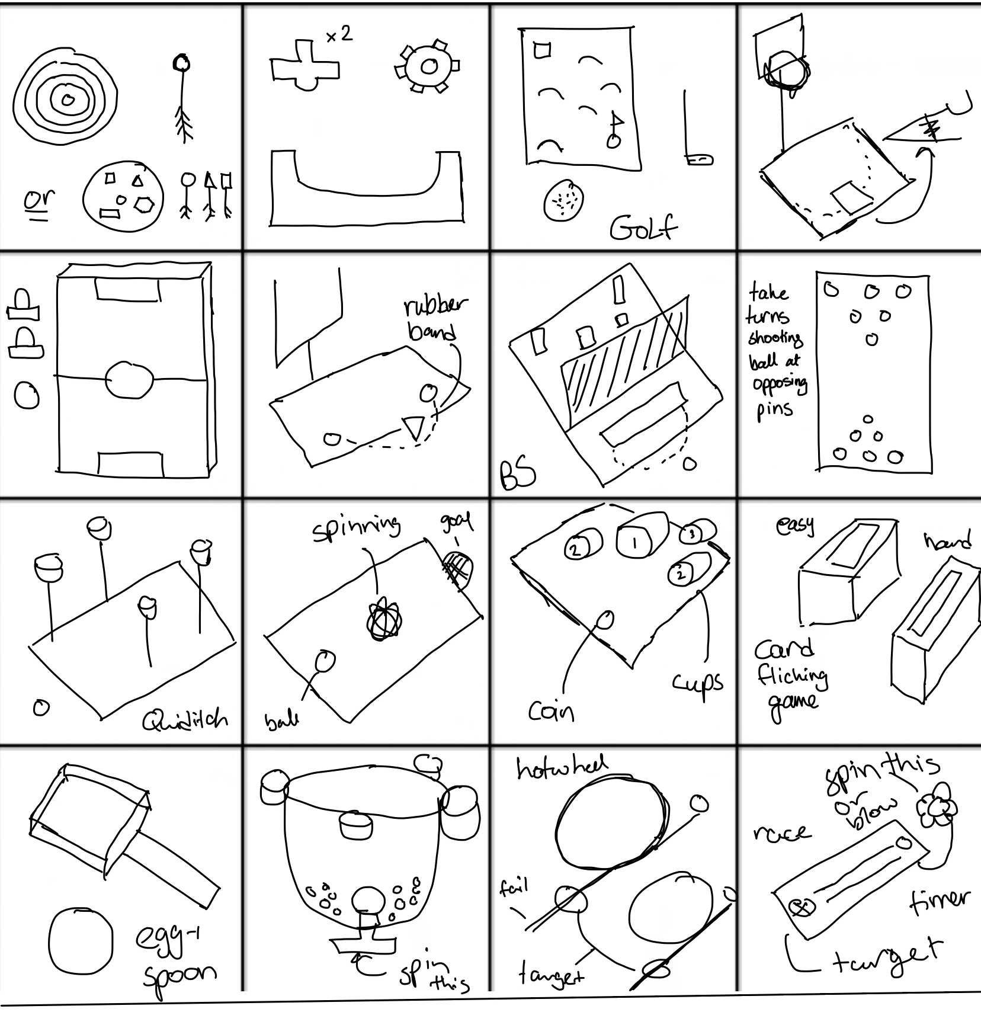
Day 1

Slide 3
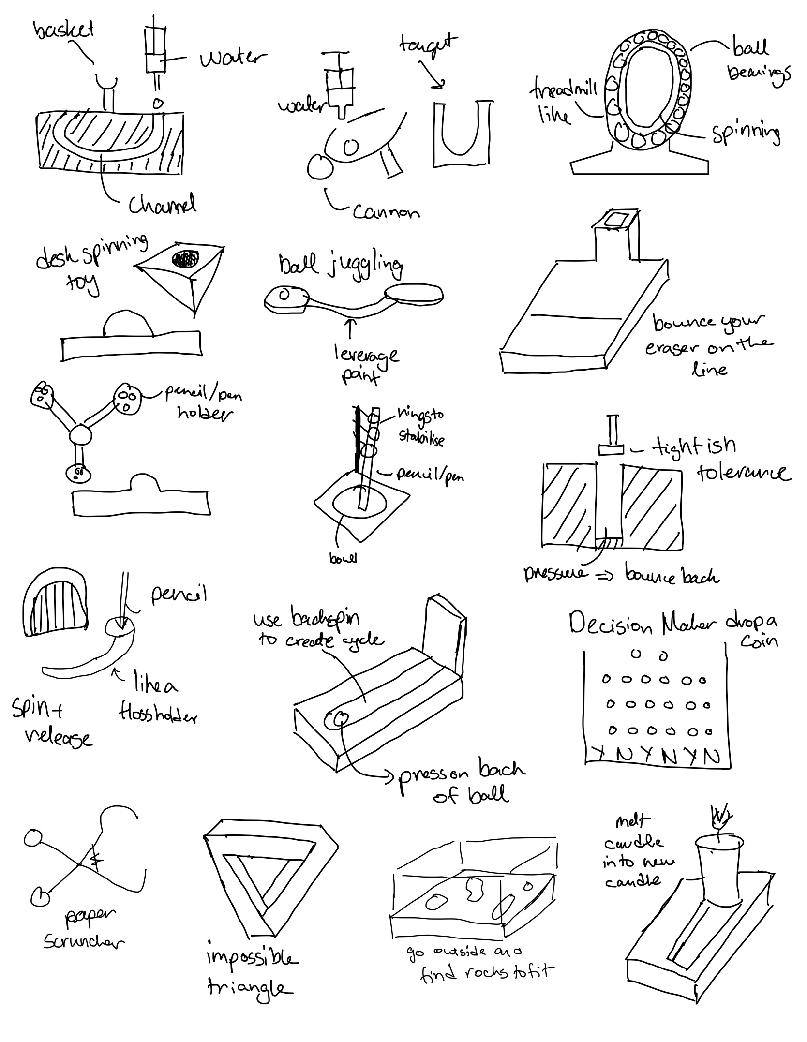
Day 2

Slide 4
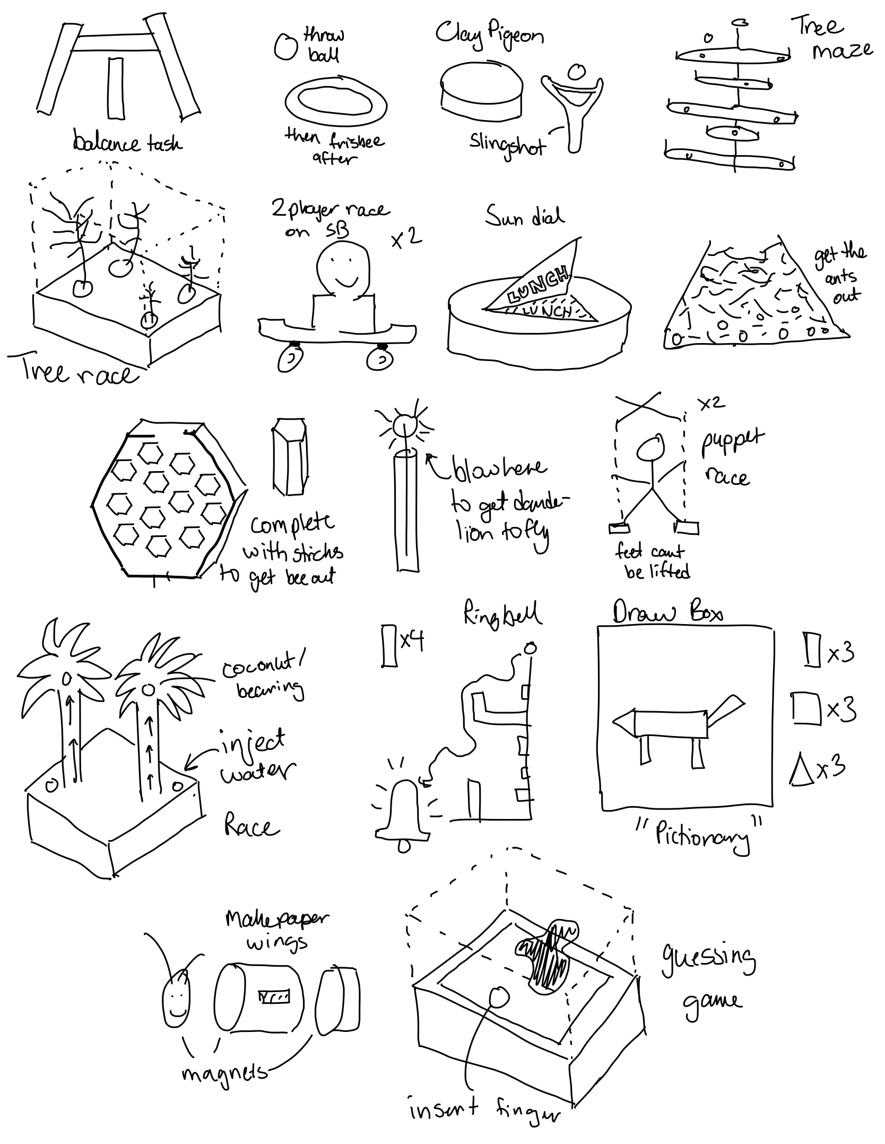

Day 3

Slide 5
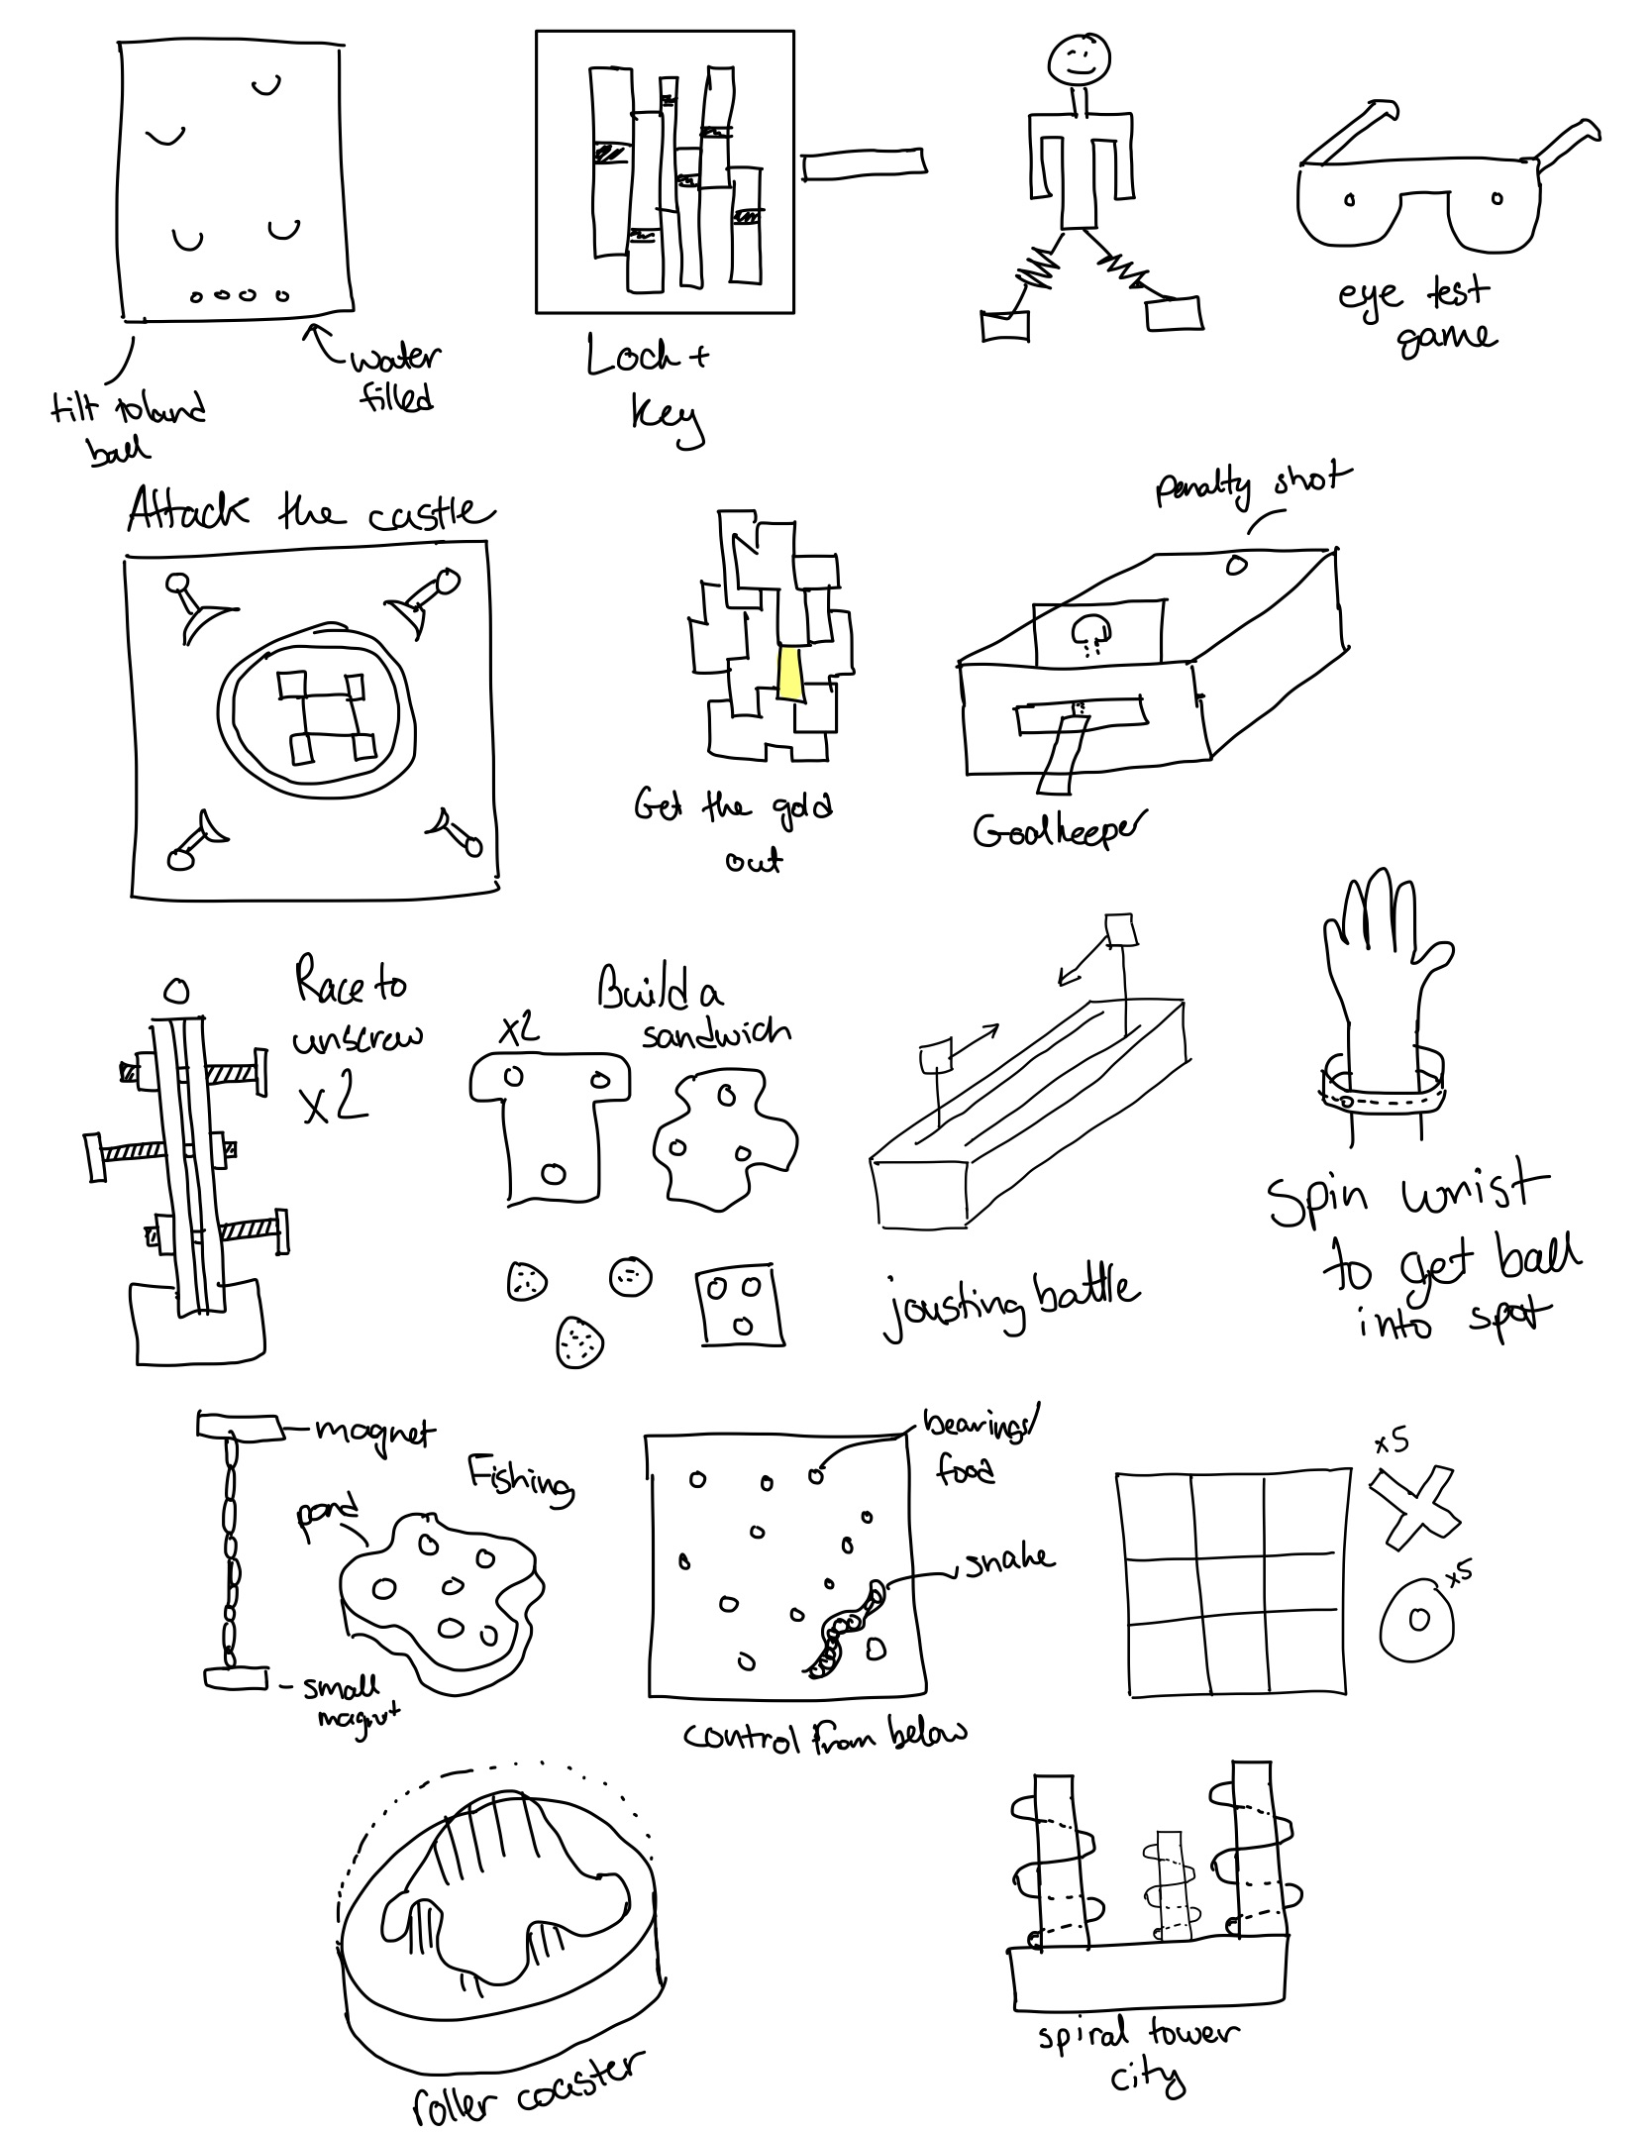

Day 4

Slide 6
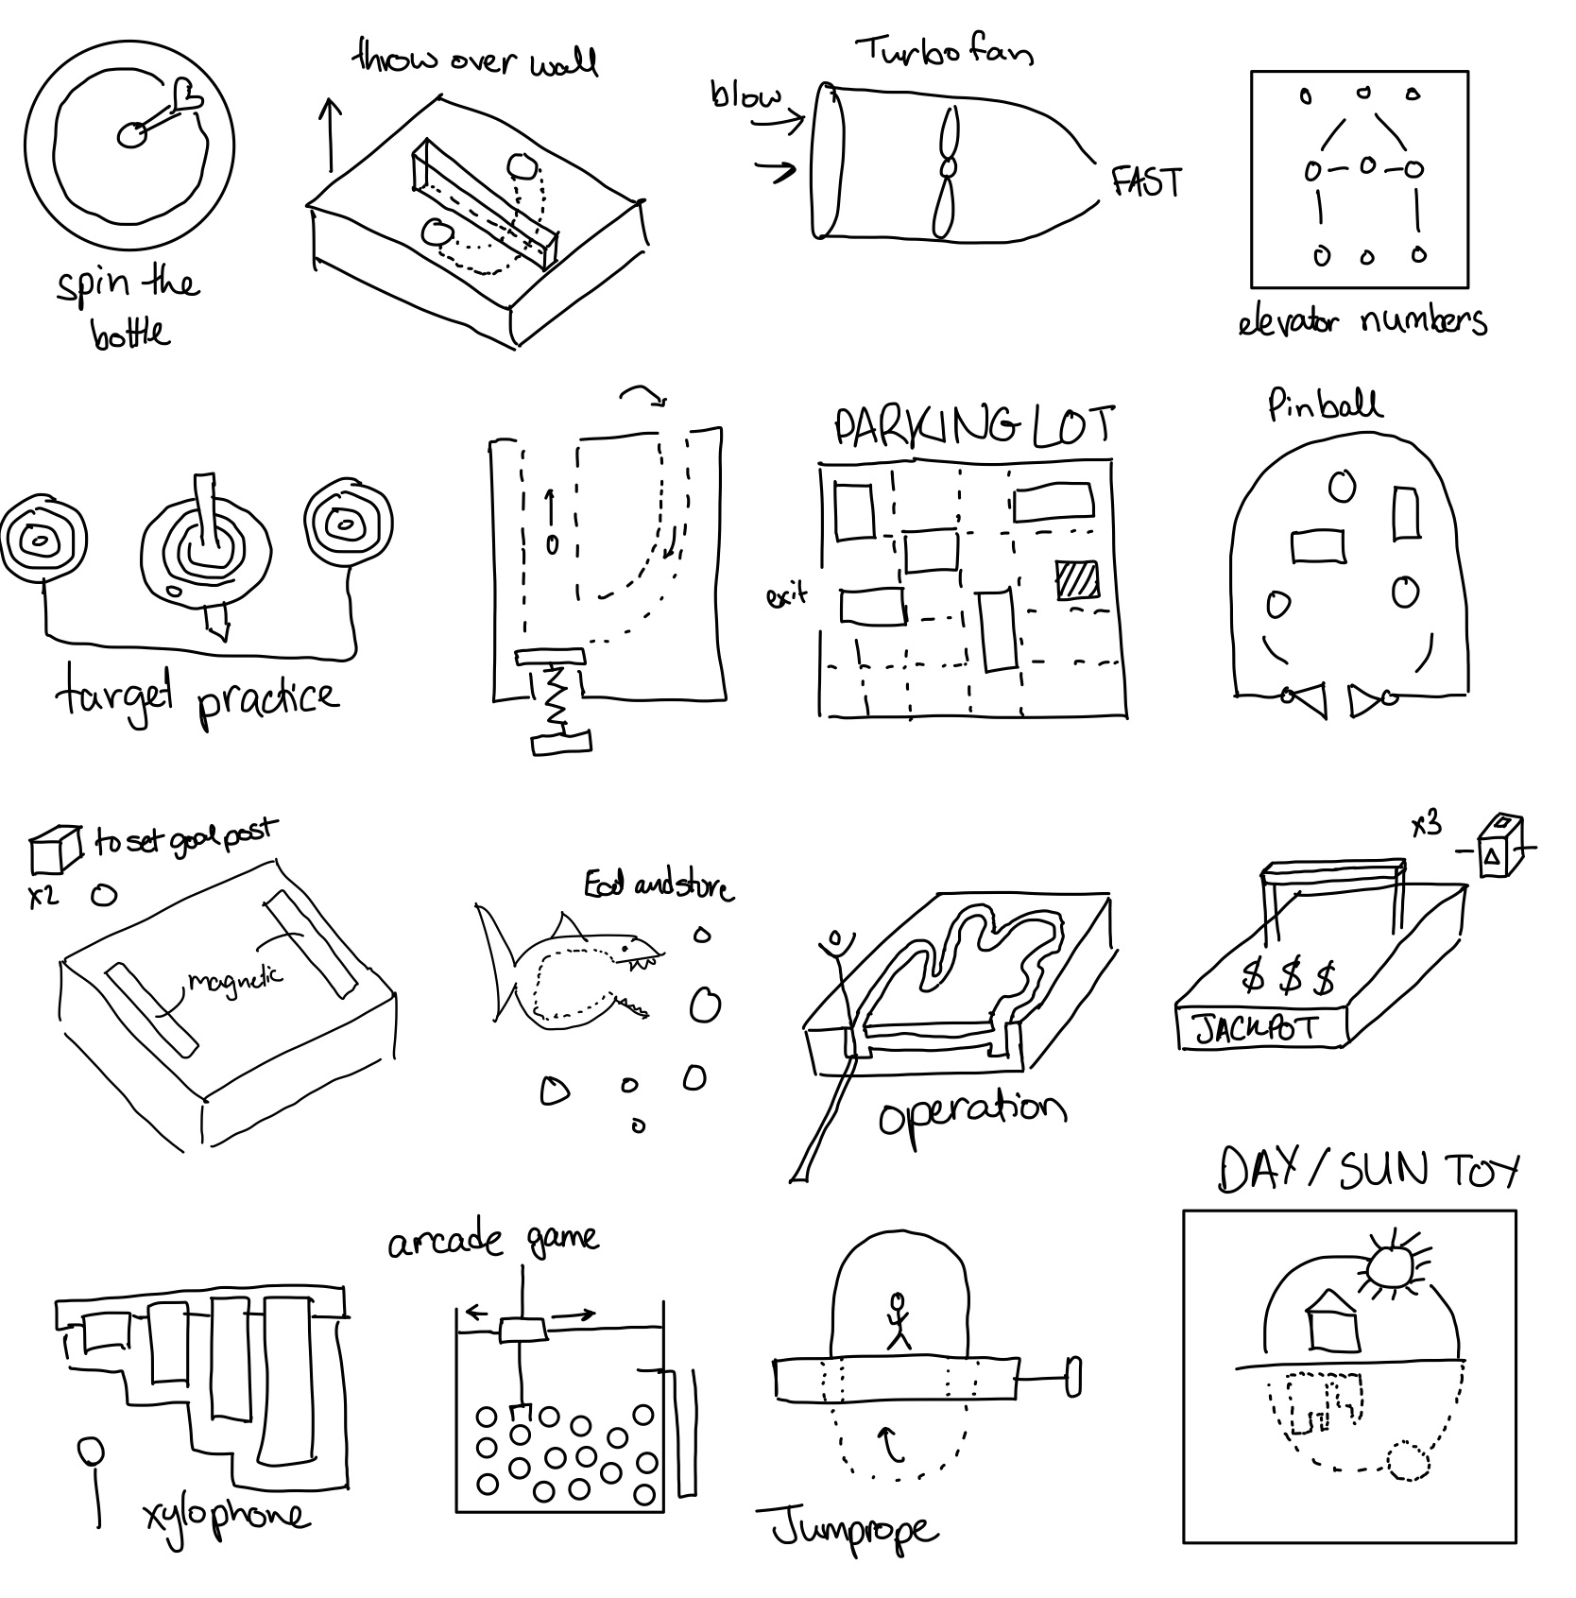

Day 5

Slide 7
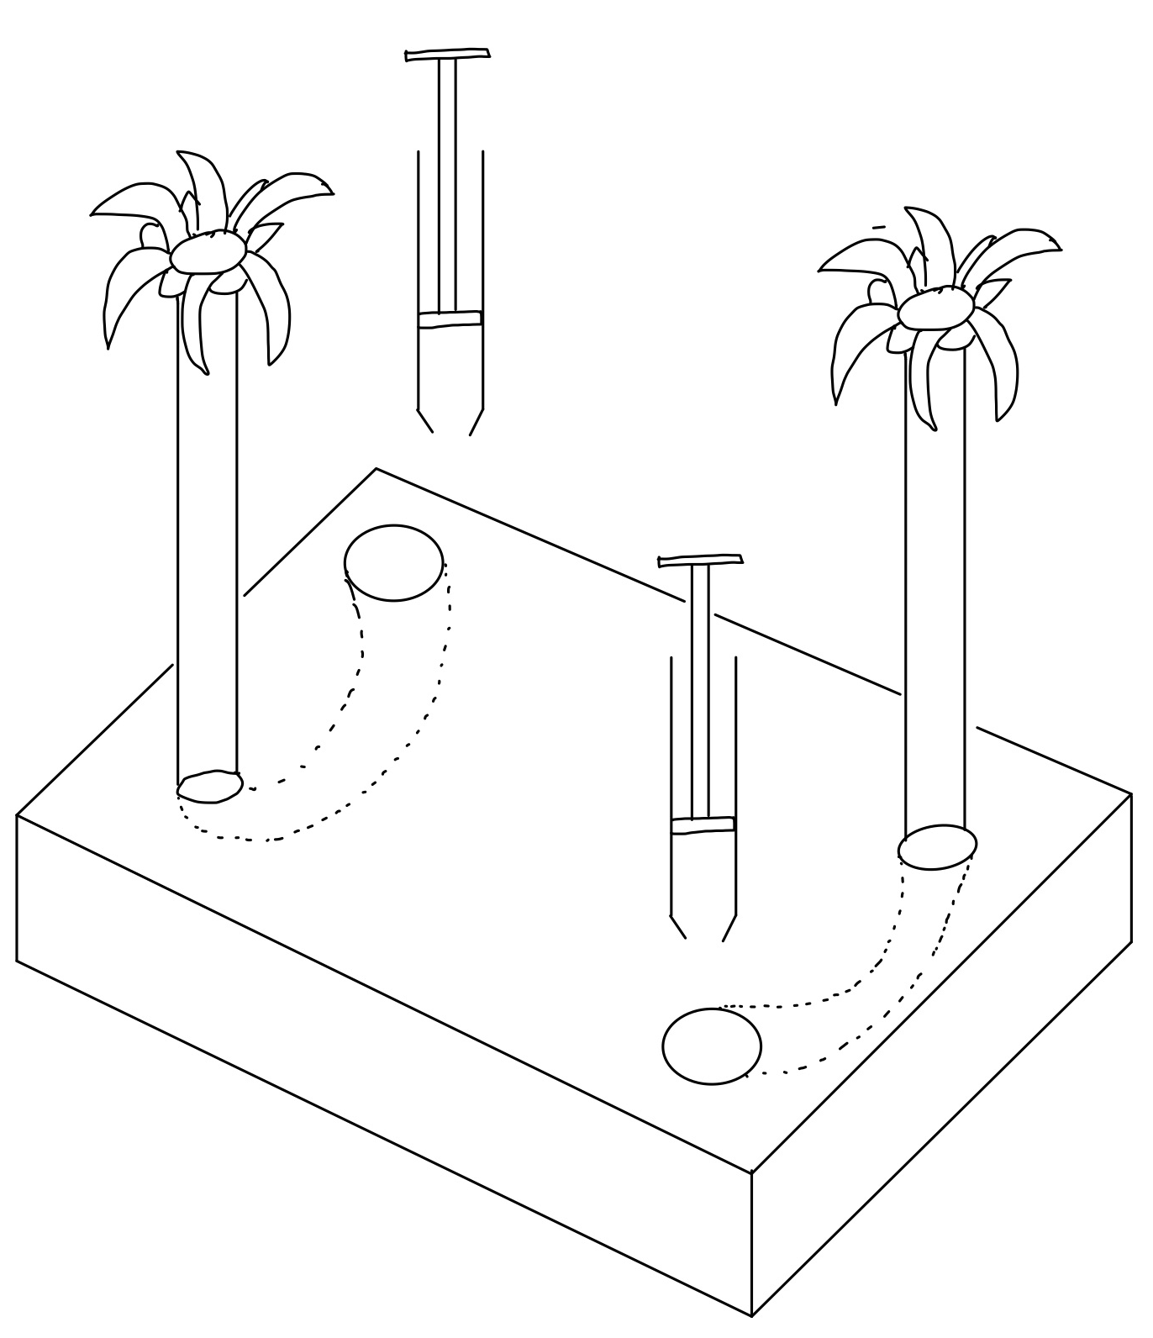


Favorite #1

Slide 8
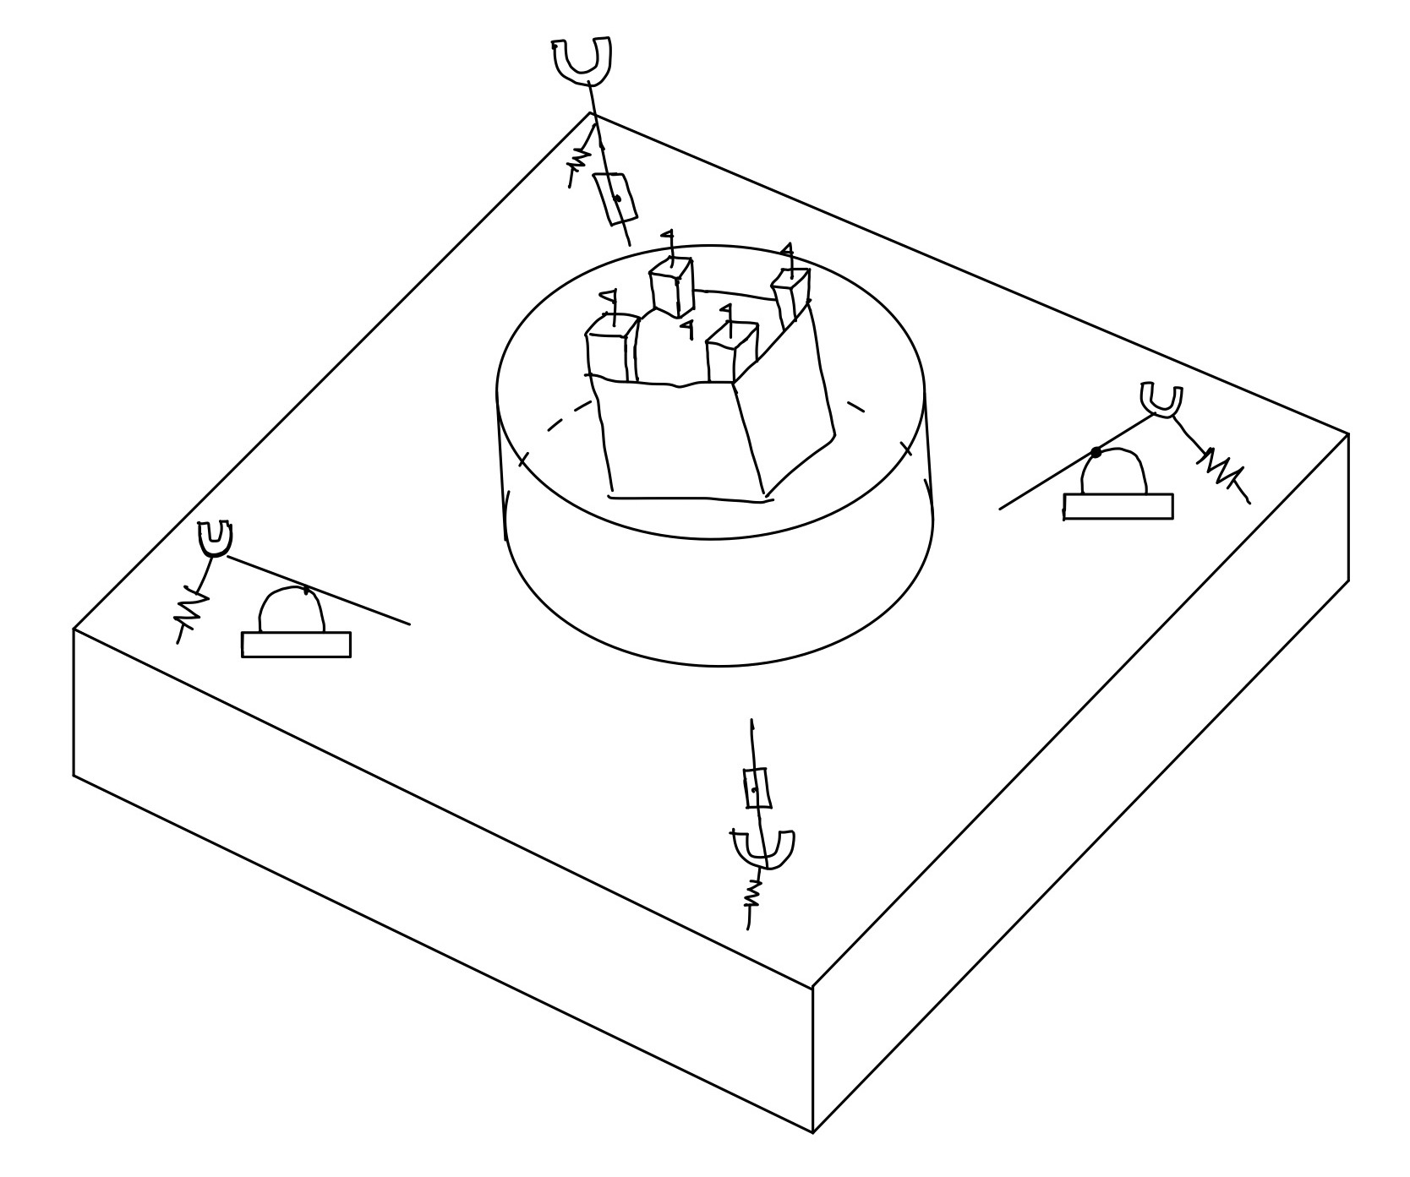

Favorite #2

Slide 9
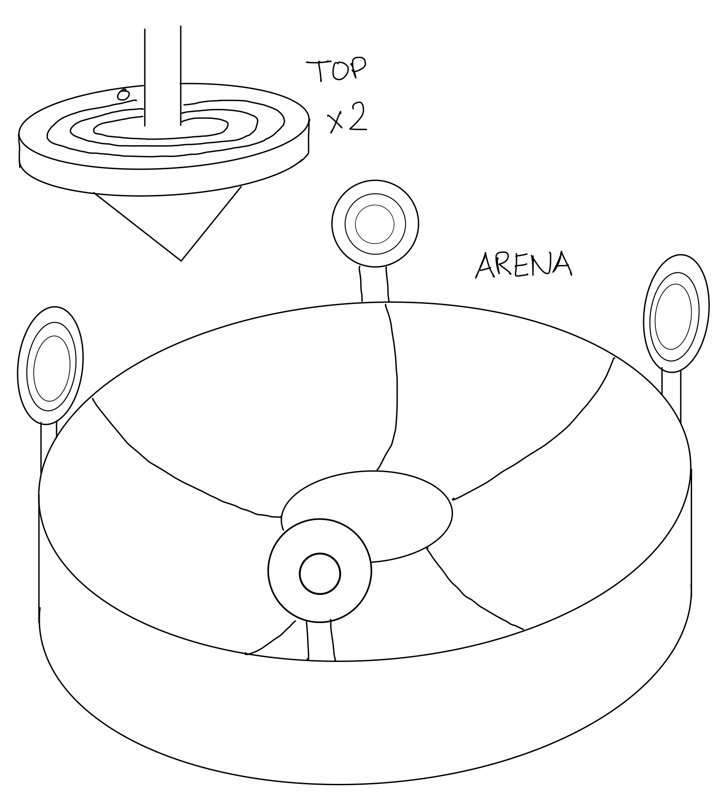

Favorite #3

